Slide 1

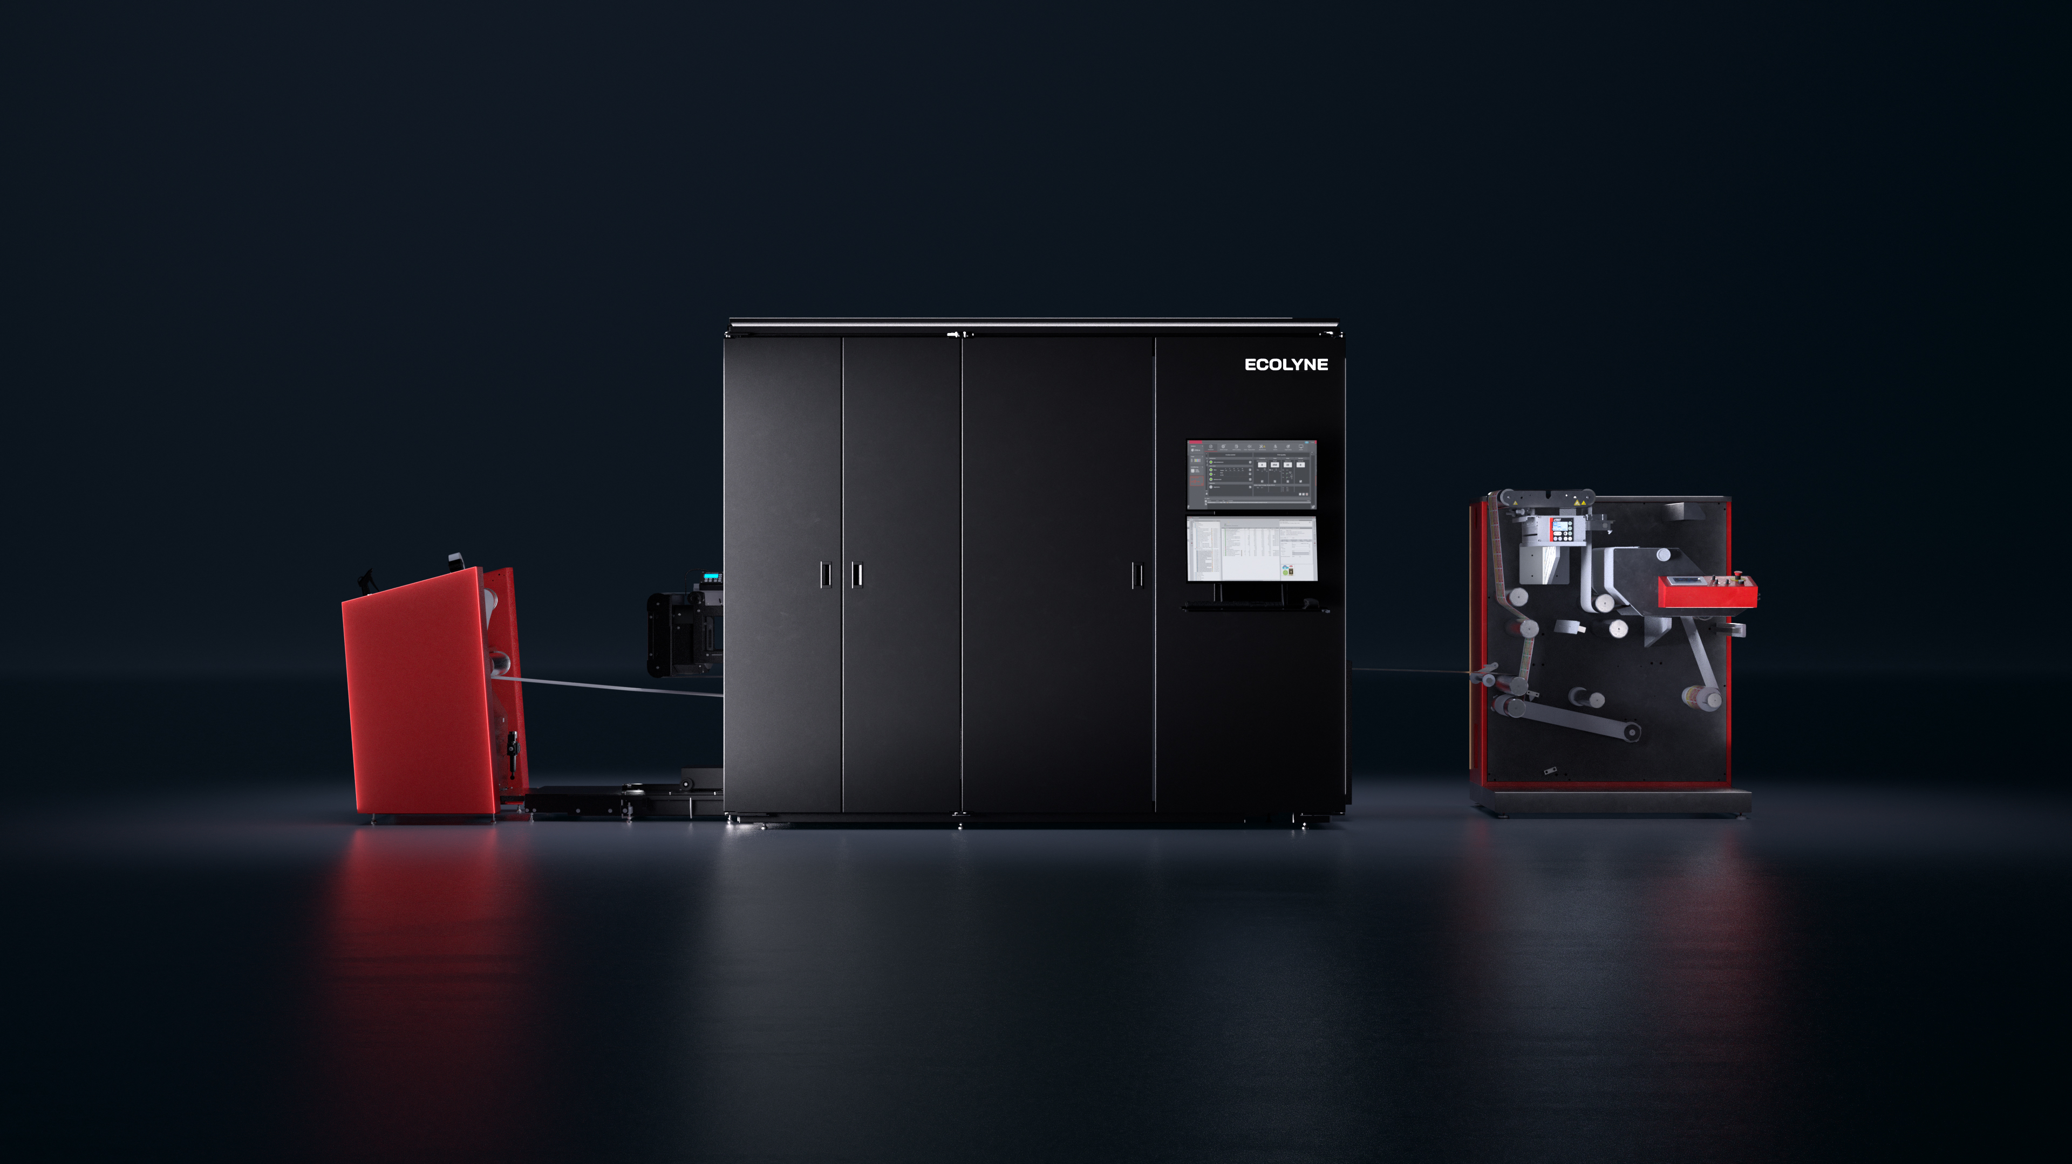
Entry-Industrial Printing. Predictable. Scalable.

Slide 2
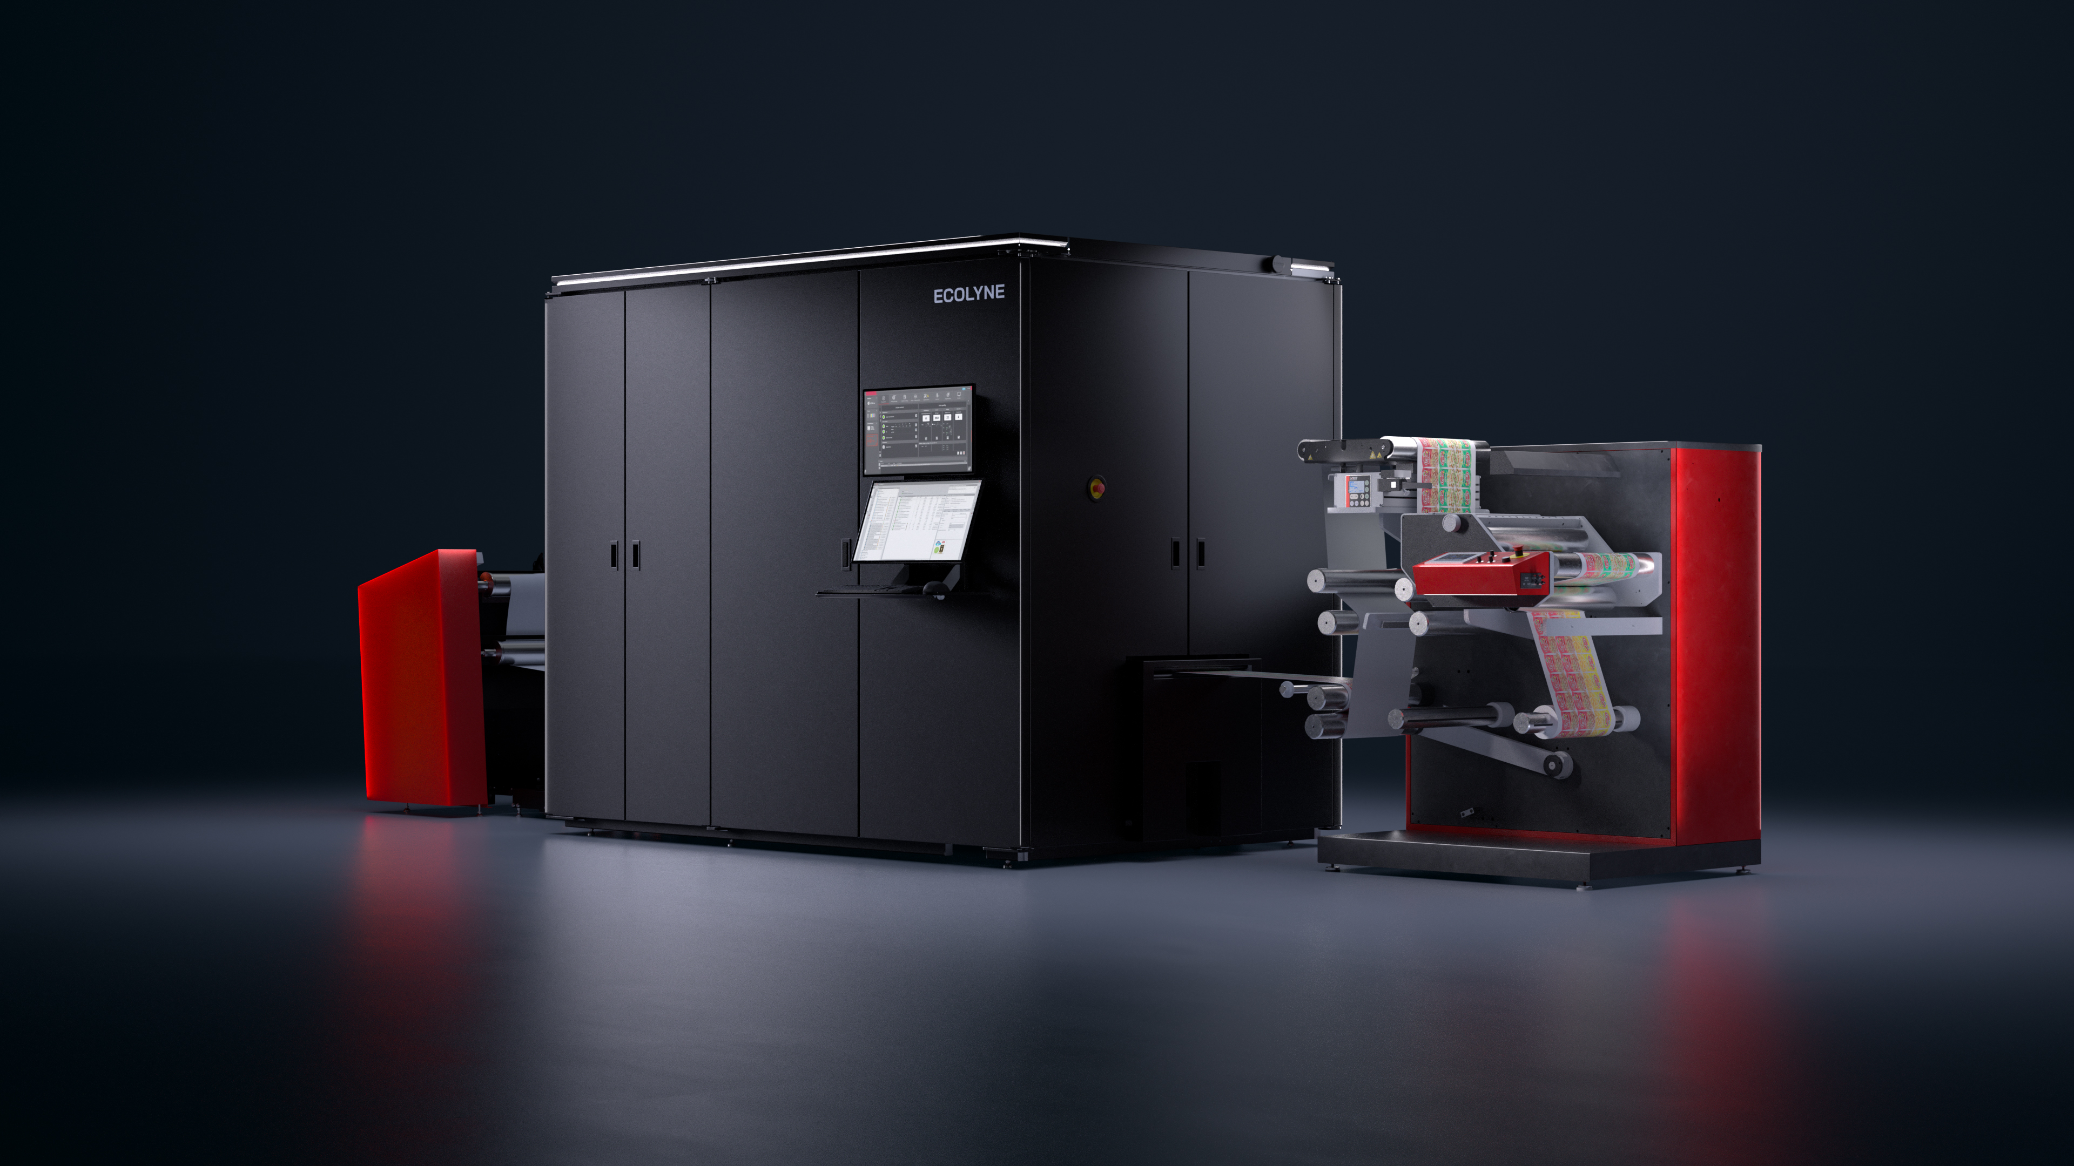




WHAT IS ECOLYNE?
Industrial-Grade Digital Printing,
Accessible
Entry-Industrial Powerhouse
A true industrial label press designed specifically for converters transitioning from office-class devices to professional production.
Engineering
Built on proven Xeikon technology, delivering robust reliability, color consistency, and food-safe toner compliance.
Capital-Free Growth
Our capacity-based model eliminates upfront CAPEX barriers, turning a heavy investment into a flexible operating expense.
Scalable Capacity
Ideal for monthly volumes of 15,000–40,000 lm, bridging the gap between entry-level units and high-volume presses.

Slide 3





WHY CAPACITY SELLING?
Print Without Investing
Unlock industrial capability with a model built for flexibility, predictability, and growth.
Predictable Costs
Scalable Growth
Risk-Free
Fast Deployment
Know your exact monthly expense in advance. One fixed fee covers equipment, service, and consumables—eliminating budget surprises.
Add capacity instantly as your business grows. Pay for additional volume only when you print it, without needing new capital approvals.
Zero depreciation risk and no obsolescence. At the end of your term, renew or upgrade to stay on the cutting edge of technology.
Shift from CAPEX to OPEX. Operational expense approvals are faster and simpler, getting you into production months sooner.

Slide 4
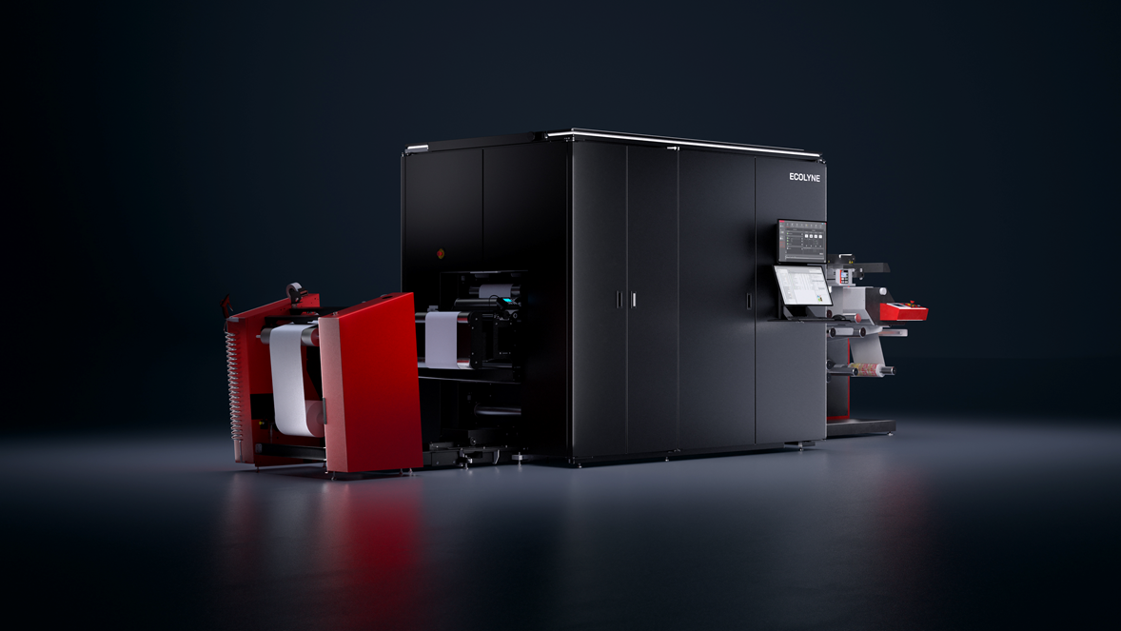

TECHNICAL CAPABILITIES
Industrial Performance
KEY SPECIFICATIONS
SPEED
PRINTING WIDTH
25 m/min
200 – 330 mm
COLORS
MEDIA WEIGHT
CMYK + White
40 – 250 gsm
SUBSTRATES
Paper, PP, PE, PET, Co-extruded films, Metallized, Clear-on-Clear
QUALITY & RELIABILITY
Proven Xeikon technology platform
Food-safe certified, Indirect contact
Consistent industrial color quality
Industrial duty cycle for 24/7 operation

Slide 5

SECTION 4 — THE CAPACITY MODEL
ECOLYNE MACHINE CONFIGURATION
Lower capacity unwinder
Straight, one color doors
Door mounted dual touch screens
Limited options
No PMC, external print medium conditioning
Simplified internal conditioning
Roll-to-Roll configuration without other finishing

Slide 6





ECOLYNE CARE
Complete Peace of Mind
Comprehensive support to keep your production running smoothly
Full Technical Support
On-site service visits and advanced remote diagnostics included
All Consumables Included
Toner, drums, and all usage parts covered — no hidden costs
Training & Onboarding
Comprehensive operator training and substrate optimization guides
Dedicated Support Access
Direct priority access to Xeikon's expert technical team
Preventive Maintenance
Scheduled maintenance visits to ensure maximum uptime

Slide 7




FLEXIBILITY & GROWTH
Grow With Confidence
A business model designed to adapt and evolve with your needs
SCALE UP OR DOWN
TECHNOLOGY REFRESH
UPGRADE PATH
Access overage capacity instantly whenever demand spikes
At end of 5-year term: renew, upgrade, or switch platforms
Seamless migration path to Xeikon CX, TX, or LX industrial lines
No penalties for lower volume months — pay only base rate
Always stay on current technology — never stuck with obsolete gear
Stay within the same proven Xeikon ecosystem and workflow
Grow production volume without triggering new CAPEX investments
Eliminate concerns about equipment resale value or disposal
Protect your production investment as your business matures

Slide 8


SUSTAINABILITY & ENVIRONMENTAL COMPLIANCE
Designed for a Better Tomorrow
Carbon Footprint
16.5 g CO2/m²
Print Energy
A
Toner Part
B
Waste Part
7.4 g CO2/m²
5.3 g CO2/m²
3.8 g CO2/m²
A
Renewable Carbon in CMYK Ink
59.1%
Free From
Compliant With
Emissions & Output
Mineral oil (>C10)
Eupia
No VOC during production
Photoinitiators
Swiss Ordinance
No VOC during printing
Reactive monomers
German Toner Ordinance
TPO
Only solid waste
Californian Prop 65
C black PAH/FDA compliant
Tin
Nestlé packaging ink
BPA
Nestlé packaging material
Polyester resin
Latex
European Toy Safety Rules
Plasticizer
ROHS heavy metals
376 mg CO2 packaging/g toner
Formaldehyde
deinking paper (Ingede)
SVHC
deinking foil (Cadel)
FDA dry food contact
Notes:
TPO : Trimethylbenzoyl Diphenylphosphine Oxide

Slide 9

PERFECT FOR
Is Ecolyne Right for You?
Growing Beyond Office Printers
Converting from office class — need industrial capability
Entering Industrial Digital
Traditional converters adding digital capability with a predictable cost model
Volume: 15,000 - 40,000 lm/month
Sweet spot for capacity model economics
Substrate Variety
Paper, films, synthetics — need flexibility without compromise
Budget-Conscious Growth
Want industrial quality without capital investment barriers

Slide 10

TECHNICAL SPECIFICATIONS
Full Specifications
PARAMETER
SPECIFICATION DETAILS
Configurations
5/0 (CMYK + White)
Printing Speed
25 m/min (Constant speed for both CMYK and White)
Media Width
200 – 330 mm
Max Imaging Width
322 mm
Imaging Length
Unlimited (Full Rotary)
Media Weight
40 – 250 gsm
Media Caliper
40 μm – 250 μm
Factory Options*
IRC (In-line Registration Camera) PPS Sensor *Factory-installed only, not field-upgradeable
Substrates (Self-Adhesive)
Paper, PP, PE, PET, Clear-on-clear, Metallized
Food Safety
Indirect food-contact composition and migration tested

Slide 11
THANK YOU
Entry-Industrial Printing.
Predictable.
Scalable.
info@innvestio-group.com

